Slide 1
Natural Language Understanding (NLU) for Automobiles
Work from Internship in Bosch
Wencan Luo, Lin Zhao
09/20/2013

Slide 2
Outline
Background
Related work
Corpus
Approaches
Future work

Slide 3
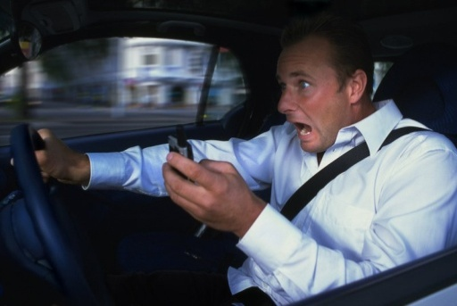
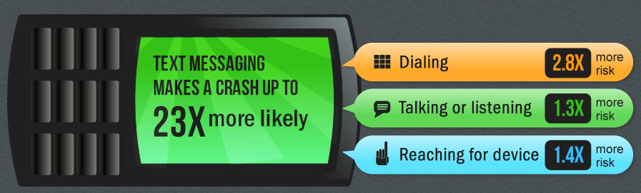
Background
Texting distracts driving
23% of auto collisions involved cell phones
5 seconds (The minimal amount of time your attention is taken away from the road when texting and driving)
23X (more likely to make a crash)
Notes:
a number of states have passed laws banning texting or wireless phones or requiring hands-free use of wireless phones while driving
http://www.ghsa.org/html/stateinfo/laws/cellphone_laws.html

Slide 4
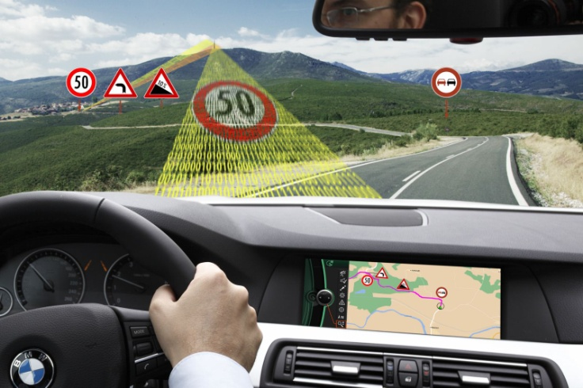
Speaking/listening is safer, natural
“where is the best chinese restaurant in palo alto”
“text my wife I will be late”

Slide 5
NLU makes it happen
“where is the best chinese restaurant in palo alto”
place to eat
cruise type
sorting by reviews
location.city
topic = routing

Slide 6
A big picture: Spoken Dialog System
ASR
Automatic Speech Recognizer
TTS
Text-to-Speech
NLU
Natural Language Understanding
NLG
Natural Language Generation
DM
Dialogue Manager
TM
Task Manager
Notes:
From

Slide 7
Related work
NLU
Produce a semantic representation appropriate for the task (Jurafsky and Martin, 2000)
Frame semantics (Fillmore, 1982)
Methods
Generative and discriminative models (Raymond and Riccardi, 2007)
CRF, SVM, Finite State Transducers
Combining different classifiers (Eun at al. 2005)
English Slot Grammar (Waston, McCord et al, 2012)
Predicate-Argument Structure
…

Slide 8
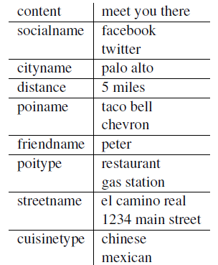
Corpus
Text Data
Collected by Amazon Mechanical Turk
Task: what will you say when given a specific topic
Topic = POI (point of interest)
Top 5
Last 5

Slide 9
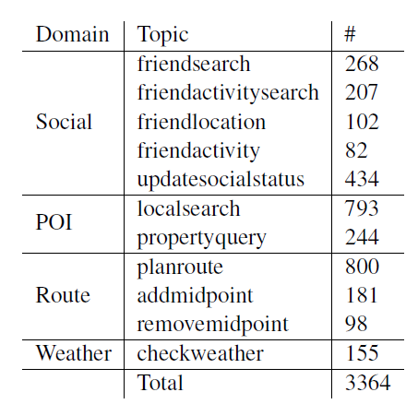
Corpus
Text Data
4 domains
11 topics
3364 transcriptions
20 slots
location
cityname
streetname
friend name
poi name
…

Slide 10
Fake data
Used as test set
Simulated data generated by hand-crafted grammar
"(.*)where is the <POI.JJ> <poiType> ( <POILocationConstraints>)?":[Topic="LocalSearch"]
368,488 sentences
skew distribution

Slide 11
Corpus
Spoken Data
1870 of sentences from TextData
A native speaker
Two speech recognition engines
Google Speech API
Vocon by NUANCE
N-Best with confidence scores

Slide 12
Challenges
A couple of ways to say the same thing
“my current location”, “my location”, “nearby”, “me”, “where i am”, “my present location”, “close me”
“restaurant”, “restaurants”, “place to buy food”, “where can i get food”, “where i can get food”, “place to eat”, “food”, “taco bell”, “chevron”
ASR errors

Slide 13
Approaches
Baseline
Hierarchical Model
Class-Based Model
N-Best Model

Slide 14
Baseline: topic/frame prediction
SVM + 1-best ASR
Feature set
Unigram
HasNegative
Lemmatized Unigram

Slide 15
Baseline: slot prediction
Sequence Labeling Problem
CRF
Features
Unigram, Bigram, Trigram
POS
Previous tag

Slide 16
Hierarchical model: does topic help?
Topic
Domain
Clustering
Slot
Slot
Slot

Slide 17
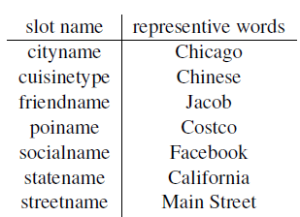
Class-based model
Replace the slot value by its name
Palo Alto -> cityname
San Francisco -> cityname
find my friends in palo alto -> find my friends in cityname
Cannot do POS
Replace by words
Not improve
useful for large vocabulary

Slide 18
N-Best model
Re-score N-Best
Upper Bound
appears in one of the N-Best
Majority Voting
picks a random one if there are more than one
Weighted Voting
considers the ASR rank
gives each candidate the weight (i + 1)/i
First None-Empty
Pick up the first non-empty slot

Slide 19
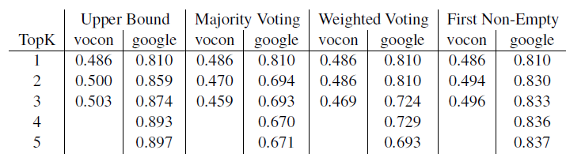
N-Best slot prediction result
Google > Vocon
Majority voting is bad
A gap to the upper bound

Slide 20
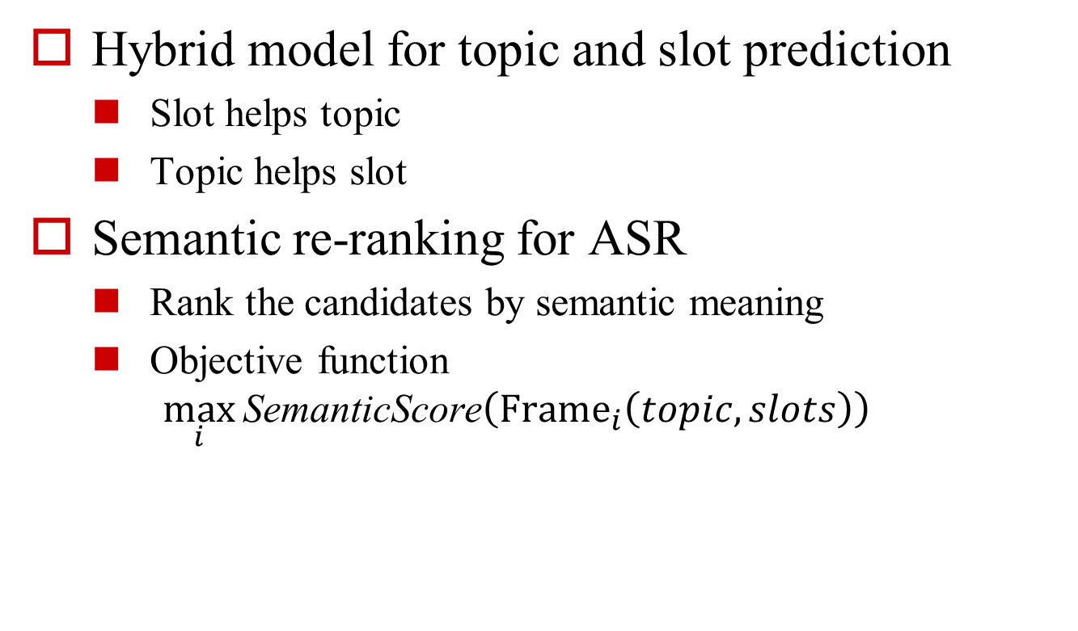
Future Work
Hybrid model for topic and slot prediction
Slot helps topic
Topic helps slot
Semantic re-ranking for ASR
Rank the candidates by semantic meaning
Objective function
$$\max_{i}{\text{Semantic}\text{Score}\left({\text{Frame}}_{i}\left(topic, slots\right)\right)}$$

Slide 21
Implementation
Sequence Labeling
CRF++
YamCha
Feature Extraction
Senna (deep learning)
POS, CHK, NER, SRL
Lemma
NLTK + WordNet
Classification
Weka

Slide 22
Reference
D. Jurafsky and J. H. Martin. 2000. Speech and Language Processing: An Introduction to Natural Language Processing. Computational Linguistics, and Speech Recognition, Prentice-Hall, Upper Saddle River, NJ.
R. Collobert, J. Weston, L. Bottou, M. Karlen, K. Kavukcuoglu and P. Kuksa. 2011. Natural Language Processing (Almost) from Scratch. Journal of Machine Learning Research (JMLR).
C. Raymond and G. Riccardi. 2007. Generative and discriminative algorithms for spoken language understanding. In Interspeech, pp. 16051608, Antwerp, Belgium, Aug. 2007.
C. J. Fillmore. 1982. Frame semantics. In Linguistics in the Morning Calm, pages 111137. Hanshin Publishing Co., Seoul, South Korea.
http://www.textinganddrivingsafety.com/texting-and-driving-stats/

